Slide 1

MACHINE LEARNING

Slide 2
HEADLINE: The Included Data Features Do Not Predict The Quality Score A Wine Will Be Given

Slide 3
3 Machine Learning Algorithms Included: 1. Multiple Regression 2. Random Forest 3. Neural Network

Slide 4
Regression Goal
Features →Target
Linear

Slide 5
Data Requirement
Feature Independence
No Correlations Nor Causations

Slide 6
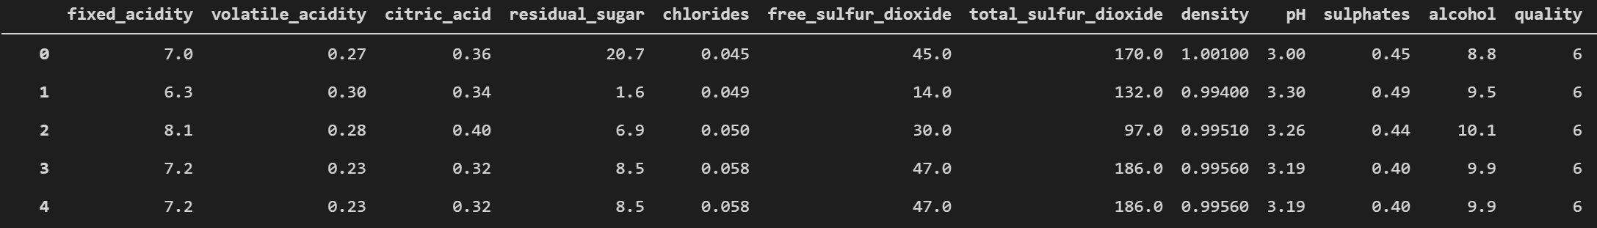
Data

Slide 7
Data

Slide 8
Data
No independence: Features All Correlated or Causal
Dependent Variable Quality is Not Described By Features

Slide 9
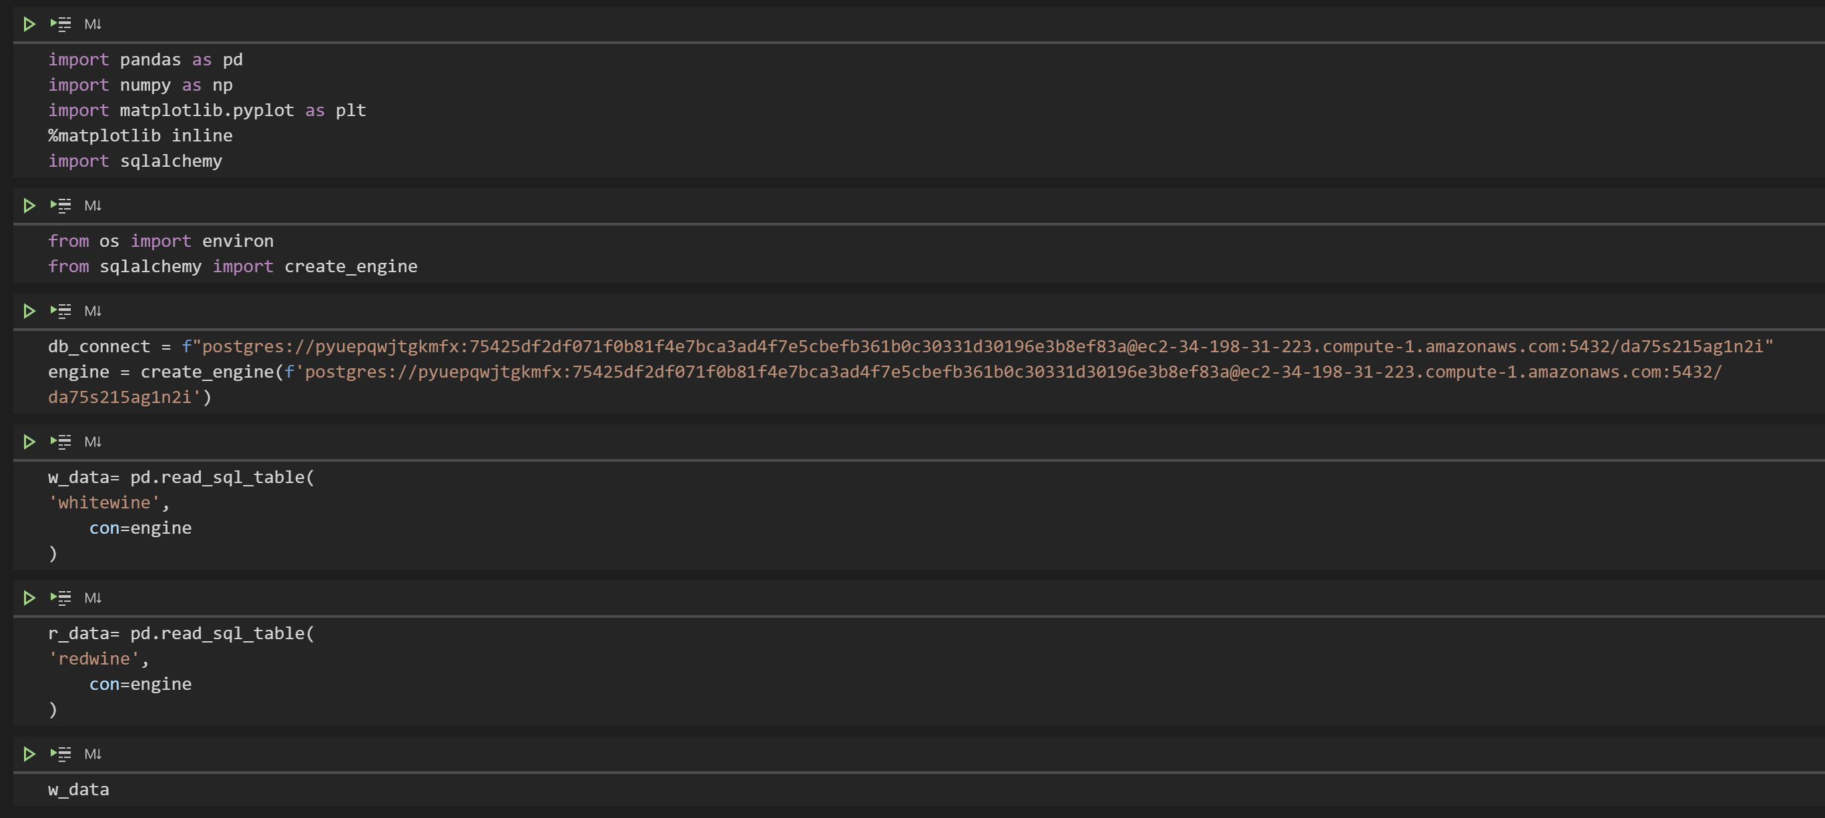
Multiple Regression
Dependencies and Data

Slide 10
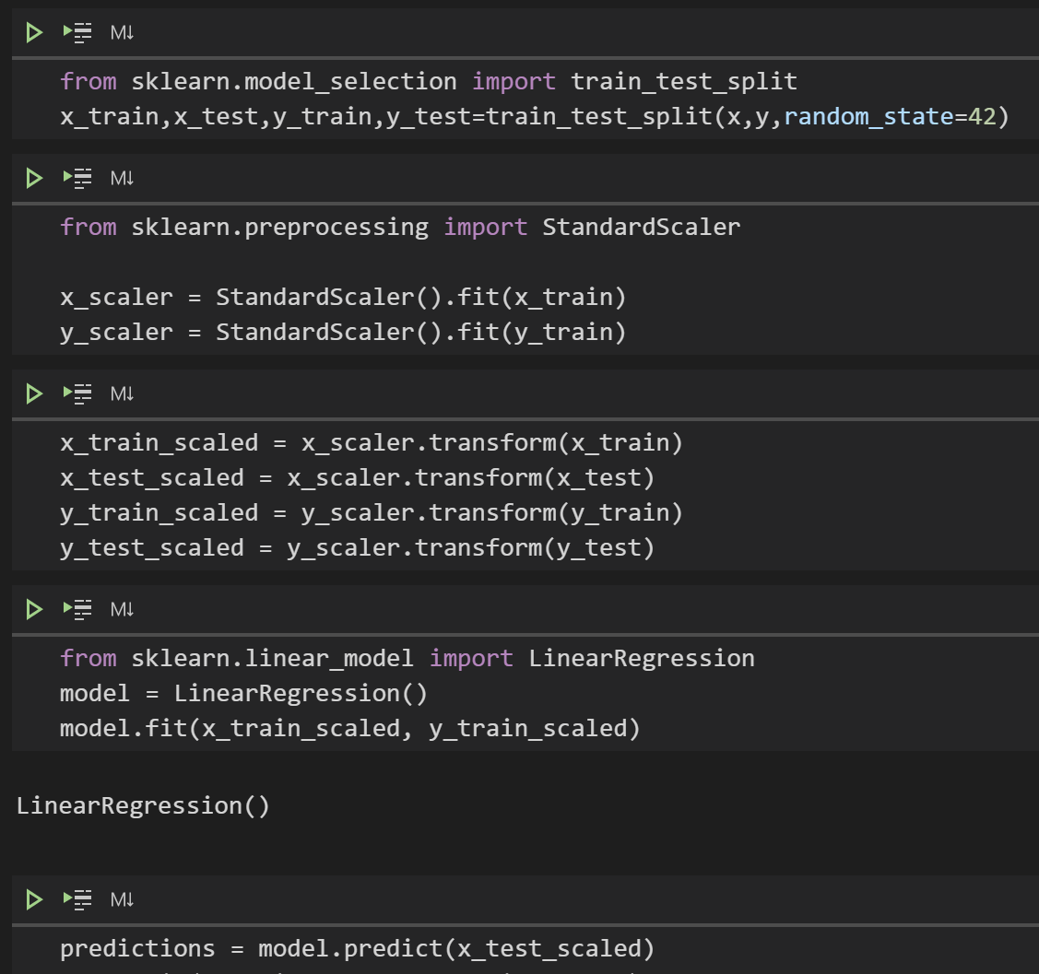
Multiple Regression

Slide 11
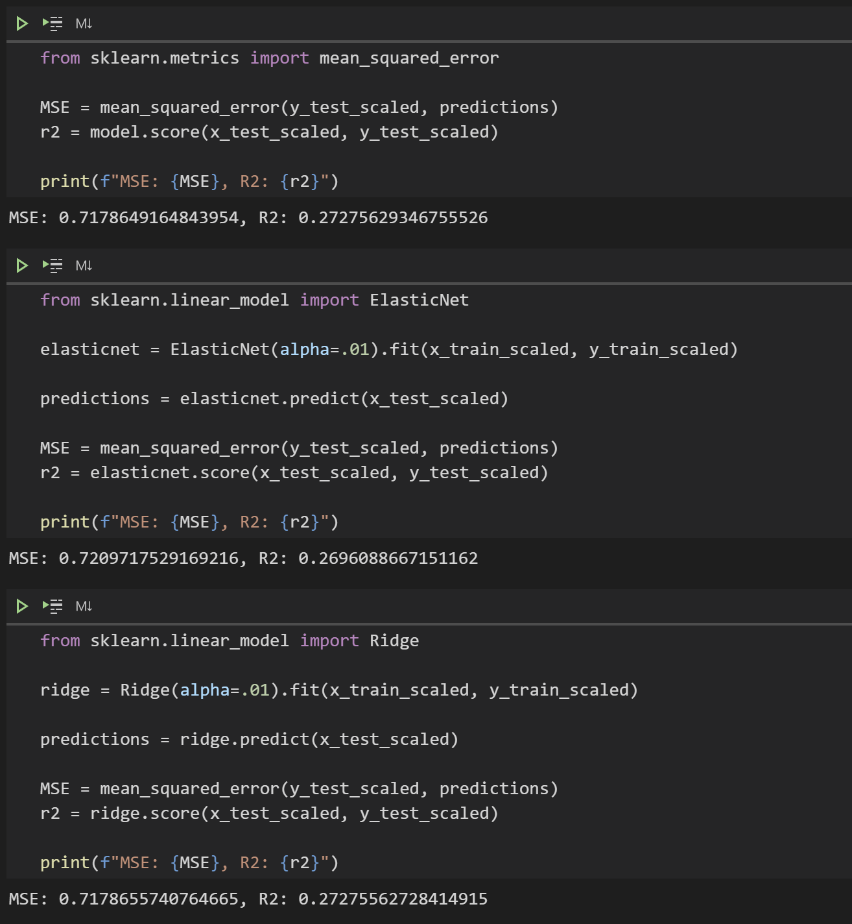
Multiple Regression

Slide 12
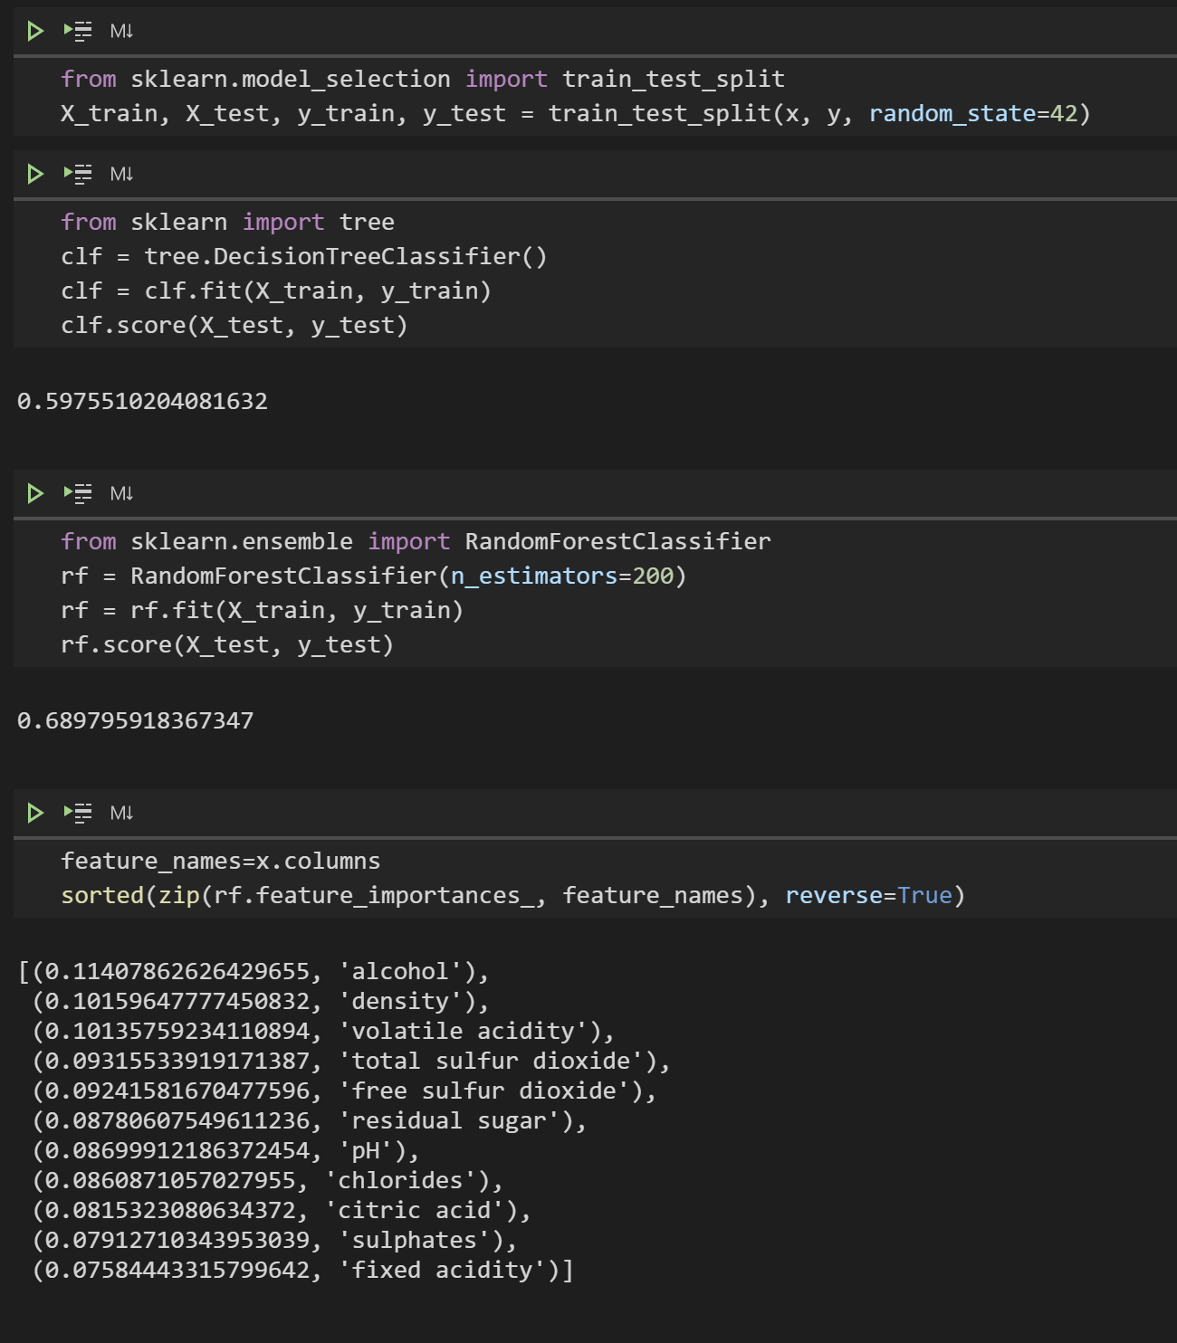
Random Forest

Slide 13
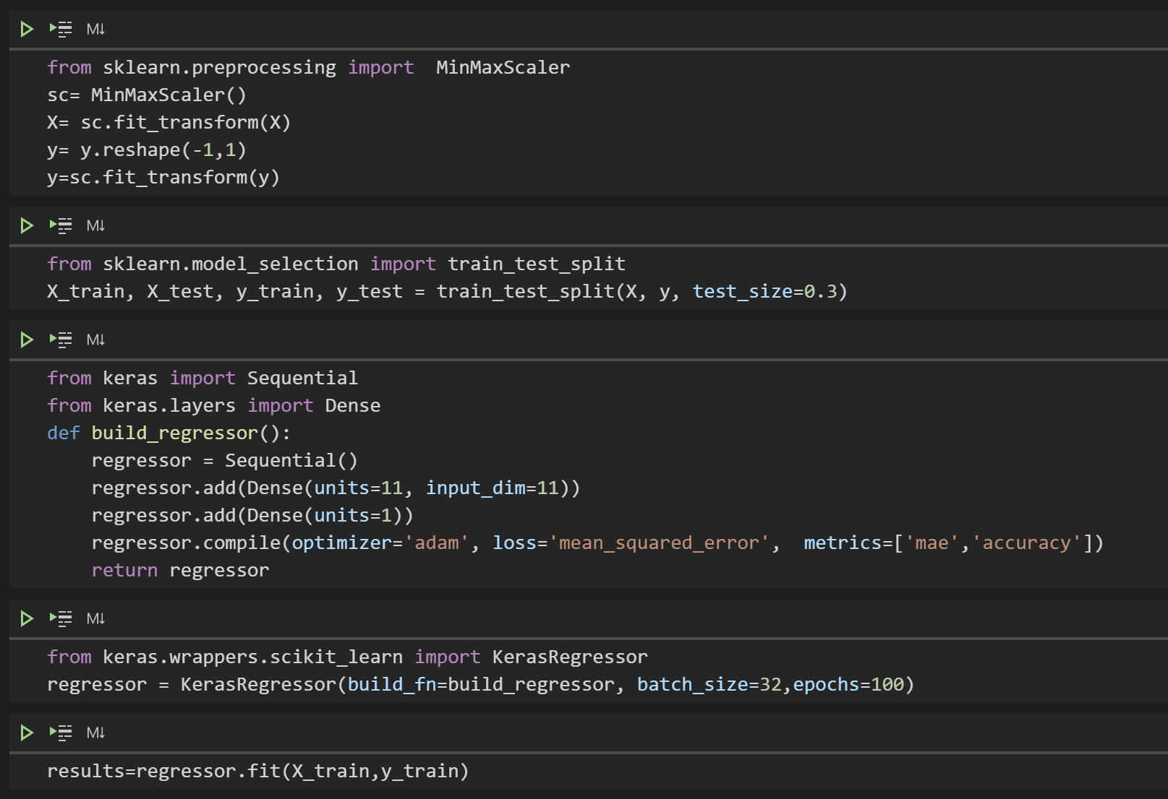
Neural Network

Slide 14
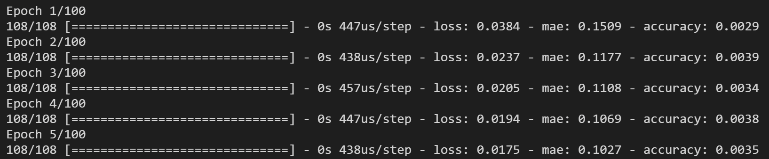
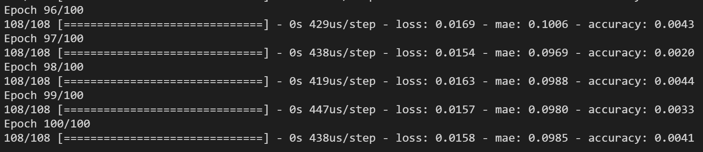
Neural Network

Slide 15
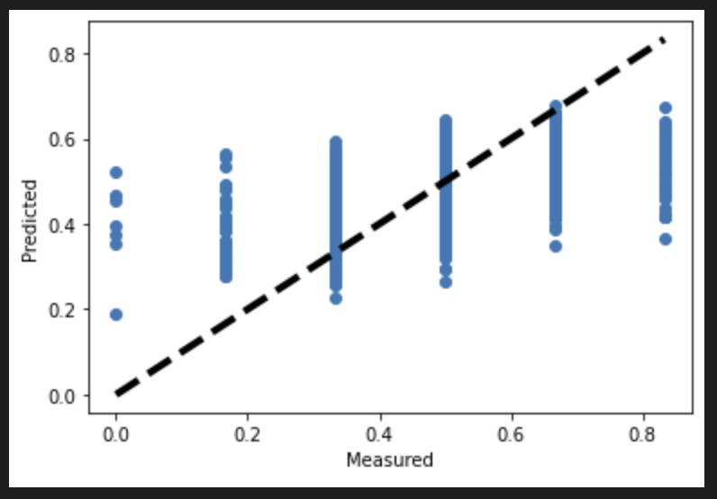
Neural Network

